Slide 1
NP-Completeness problems
Session 22
Henry Lucky, S.Kom. M.Kom.

Slide 2
Outline Materials
Session 04
NP-Complete problems
Vertex-cover problem
Hamiltonian cycle problem
Travelling sales-person problem
Subset-sum problem
Reduction strategies

Slide 3
The figure in the next slide outlines the structure of the NP-completeness proofs in this section.
We prove each language in the figure to be NP-complete by reduction from the language that points to it.
At the root is CIRCUIT-SAT, which we will prove NP-complete here.

Slide 4
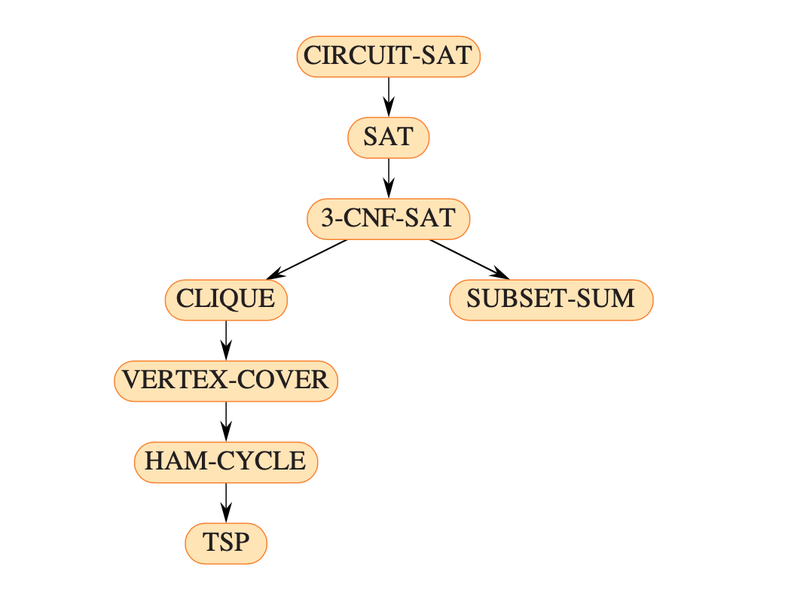

Slide 5
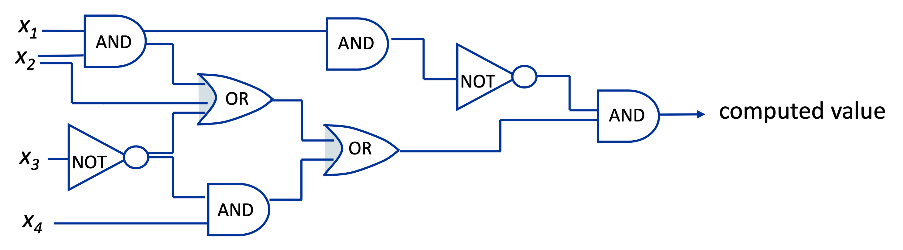
A First NP-complete problem
Circuit-SAT (circuit-satisfiability)
Input: Boolean combinatorial circuit
Question: Can input variables be set such that circuit evaluates the output to true (1)?

Slide 6
Lemma 1: Circuit-SAT is in NP
Proof:
Must show that there exists a polynomial-time verifier.
Consider “yes”-instance x (so: x = description of satisfiable circuit)
certificate y: take satisfying truth assignment
We can easily check in polynomial time if truth assignment produces TRUE.

Slide 7
Lemma 2: For every problem A in NP, we have: A ≤_{P} Circuit-SAT
Proof:
Step 1: show the following:
if an algorithm runs in polynomial time, then there is a polynomial-size boolean circuit that “implements” the algorithm, and such a circuit can be constructed in polynomial time
(idea: algorithm runs on computer that is essentially a Boolean circuit)

Slide 8
Lemma: For every problem A in NP, we have: A ≤_{P} Circuit-SAT
Proof:
Step 2: Describe algorithm that performs reduction:
A in NP, so A has verification algorithm VER(x,y) that checks if x is “yes”-instance using certificate y. Construct circuit implementing VER.
“Fix” the variables corresponding to x according to the given input
Run Circuit-SAT: Circuit-SAT returns “yes” if x is “yes” instance for problem A
x₁
circuit implementing VER
x_{n}
y₁
y_{m}

Slide 9
Lemma 1: Circuit-SAT is in NP
Lemma 2: For every problem A in NP, we have: A ≤_{P} Circuit-SAT
(in other words: Circuit-SAT is NP-hard).
Theorem: Circuit-Sat is NP-complete.

Slide 10
Proving NP-Completeness of other problems
Theorem: If problem A is NP-hard and problem A ≤_{P} problem B,
then problem B is also NP-hard.
General strategy to prove that a problem B is NP-complete
Select problem A that is known to be NP-complete.
Prove that A ≤_{P} B:
Describe reduction algorithm, which maps instances x of A to instances f (x) of B.
Prove that x is “yes”-instance for A if f (x) is “yes”-instance for B
Prove that reduction algorithm runs in polynomial time
(Now you have shown that B is NP-hard.)
Prove that B is in NP by giving polynomial-time verification algorithm.

Slide 11
Proving NP-Completeness of other problems: Example
SATISFIABILITY
Input: A Boolean formula
Question: Is the formula satisfiable ?
( (x₁ → ¬x₃) ↔ (x₁ V ¬x₂ V x₃) ) Λ (¬ (x₂ V x₃ V x₅) → (x₁ V x₃ V x₄) )

Slide 12
Theorem: SATISFIABILITY is NP-complete.
Proof:
Select known NP-complete problem: Circuit-SAT
Prove that Circuit-SAT ≤_{P} SATISFIABILITY
Describe reduction algorithm, which maps instances x of A to instances f (x) of B.
Prove that x is “yes”-instance for A if f (x) is “yes”-instance for B
Prove that reduction algorithm runs in polynomial time
Prove that SATISFIABILITY is in NP by giving polynomial-time verification algorithm.

Slide 13
Reduction algorithm: convert Boolean circuit into Boolean formula
introduce variable for every wire w_{i} (including input and output wires)
write clause for every gate:
Boolean formula: (output-wire variable) Λ conjunction of gate-clauses
check: − reduction uses polynomial time
− Boolean circuit satisfiable if Boolean formula satisfiable
w_{i}
w_{k}
AND
( w_{i} Λ w_{j} ) ↔ w_{k}
w_{j}
problem: shared “sub-circuits”
➔
cannot convert in straightforward top-down manner

Slide 14
Theorem: SATISFIABILITY is NP-complete.
Proof:
Select known NP-complete problem: Circuit-SAT
Prove that Circuit-SAT ≤_{P} SATISFIABILITY
Describe reduction algorithm, which maps instances x of A to instances f (x) of B.
Prove that x is “yes”-instance for A if f (x) is “yes”-instance for B
Prove that reduction algorithm runs in polynomial time
DONE
Prove that SATISFIABILITY is in NP by giving polynomial-time verification algorithm.
EASY

Slide 15
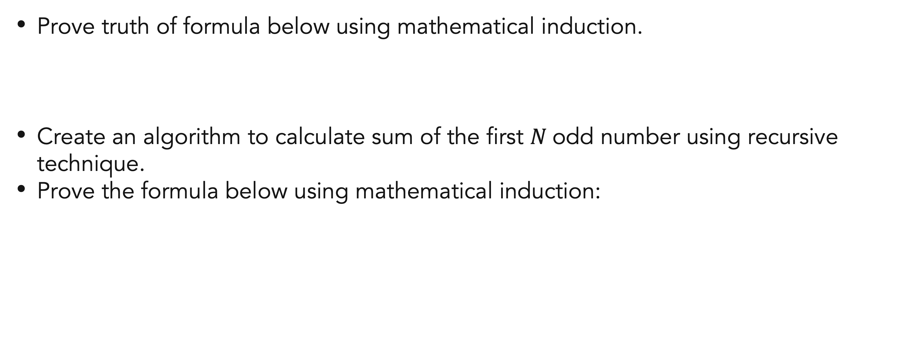
Exercises
Mathematical induction
Prove truth of formula below using mathematical induction.
Create an algorithm to calculate sum of the first $N$odd number using recursive technique.
Prove the formula below using mathematical induction:

Slide 16
References
Thomas H. Cormen. (2022). Introduction to algorithms: Fourth edition. The MIT Press. Chapter 3.

Slide 17
Thank you
Mathematical Induction And Recursive Function
September, 2023

